Slide 1
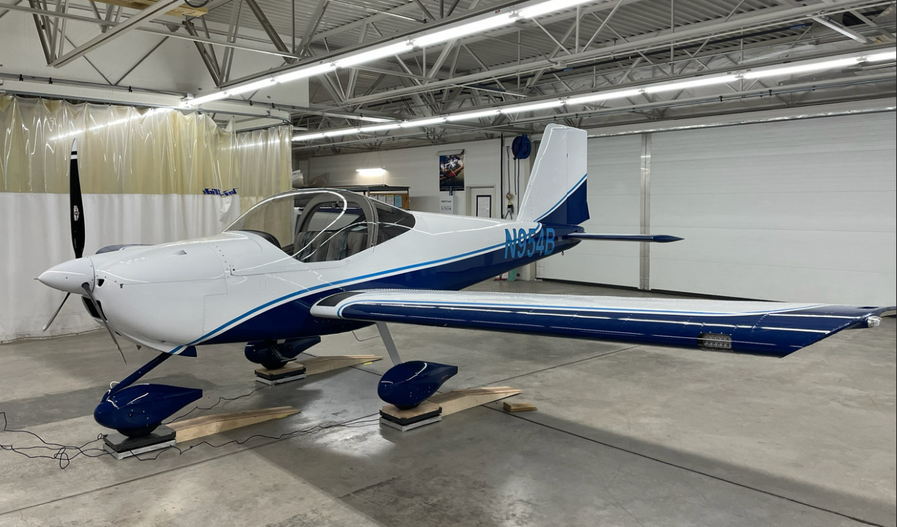
RV-12iS

Slide 2
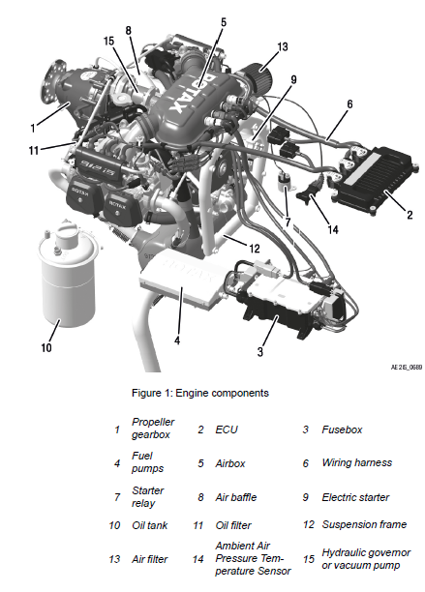
Rotax 912iS
Basics of Rotax 912iS
100 BHP
4 cylinder horizontally opposed
Liquid cooled cylinder heads
Red coolant
Ram air cooled cylinders
Dry sump
Fully redundant electronic engine management system (EMS)
Propeller driven via gearbox
Oil tank
Electric starter
Fuel pump

Slide 3
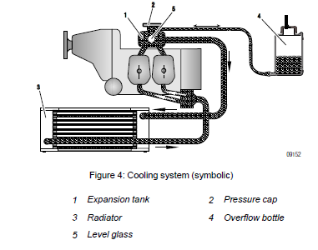
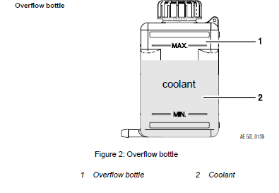
Cooling System
Designed for liquid cool of the cylinder heads and ram-air cooling of the cylinders.
The coolant is forced by a water pump driven from the camshaft from radiator to the cylinder heads.
Coolant passes from the top of cylinder heads to the expansion tank.
From the expansion tank the coolant is sucked back to the water pump.
Notes:
Since the standard location of the radiator is below engine
level, the expansion tank located on the top of the engine allows
for coolant expansion.

Slide 4
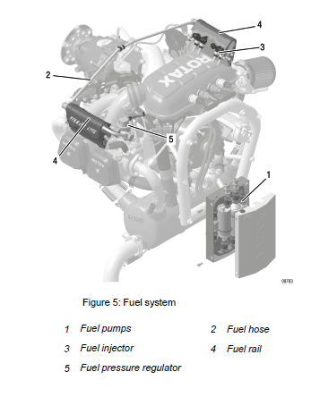
Fuel System
Fuel flows from the tanks through a filter to the electric fuel pumps then through a fine filter to fuel rails then to fuel injectors and then to fuel pressure regulator.
Both fuel pumps remain ON during flight.
The engine has an electronic fuel injection system, controlled by the Engine Control Unit (ECU) this allows for highly accurate metering of fuel

Slide 5
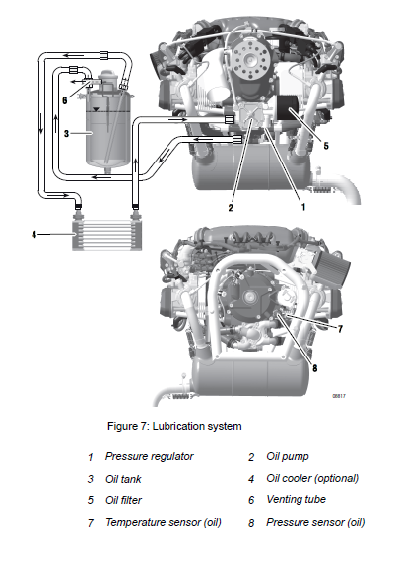
Lubrication System
The Rotax 912iS is a dry sump the oil pump (driven by the camshaft) sucks the oil from the oil tank through the oil cooler and forces is through the oil filter to the point lubrication in the engine.
Excess oil accumulates and the bottom of the crankcase and is forced back to oil tank by the piston blow-by gases.
https://youtu.be/Mdaf4xphhjQ

Slide 6
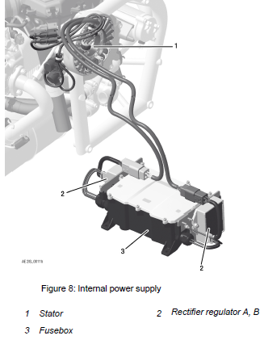
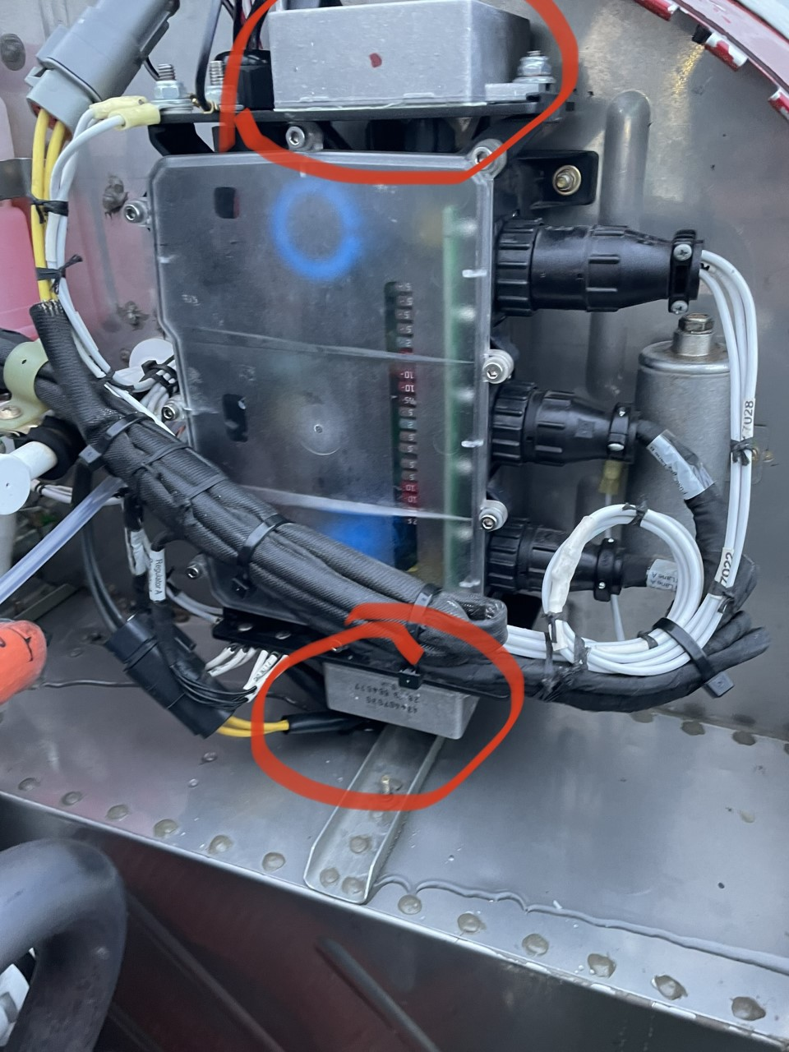
Electrical System
The Rotax 912iS electrical system is responsible for supplying power to the Engine Management System (EMS) and airframe.
The two generators also known as a stator (two invidual stators in the same stator casing) with two external rectifier-regulators (located on fuse box)
The stator housing is on the very back of the engine.
The rectifier-regulators convert the AC power coming out of the stator to DC and regulate it to ~14V.
The fusebox manages the energy and allows the selecting of whether the EMS is supplied by the battery or one of the generators.
The Engine Control Unit (ECU) automatically controls which generator is powering the EMS.
Malfunction: If the EMS power supply (Generator A) fails the ECU automatically switches one-time over to the second EMS power supply (Generator B). No charging of the aircraft battery occurs during this mode.

Slide 7
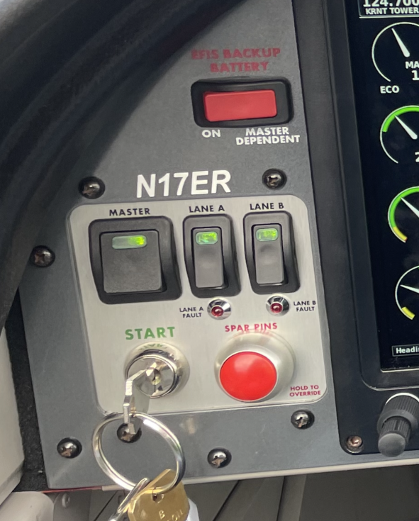
Engine Management System (EMS)
Functions:
Ignition control
Fuel injection control
Fault detection
(Internal-) Generator management
The core of the EMS is the Engine Control Unit (ECU) which consist of two modules. These are known as Lane A & Lane B each one capable of taking over control, regulation and monitoring of the engine.
Not the same as rectifier A &B.

Slide 8
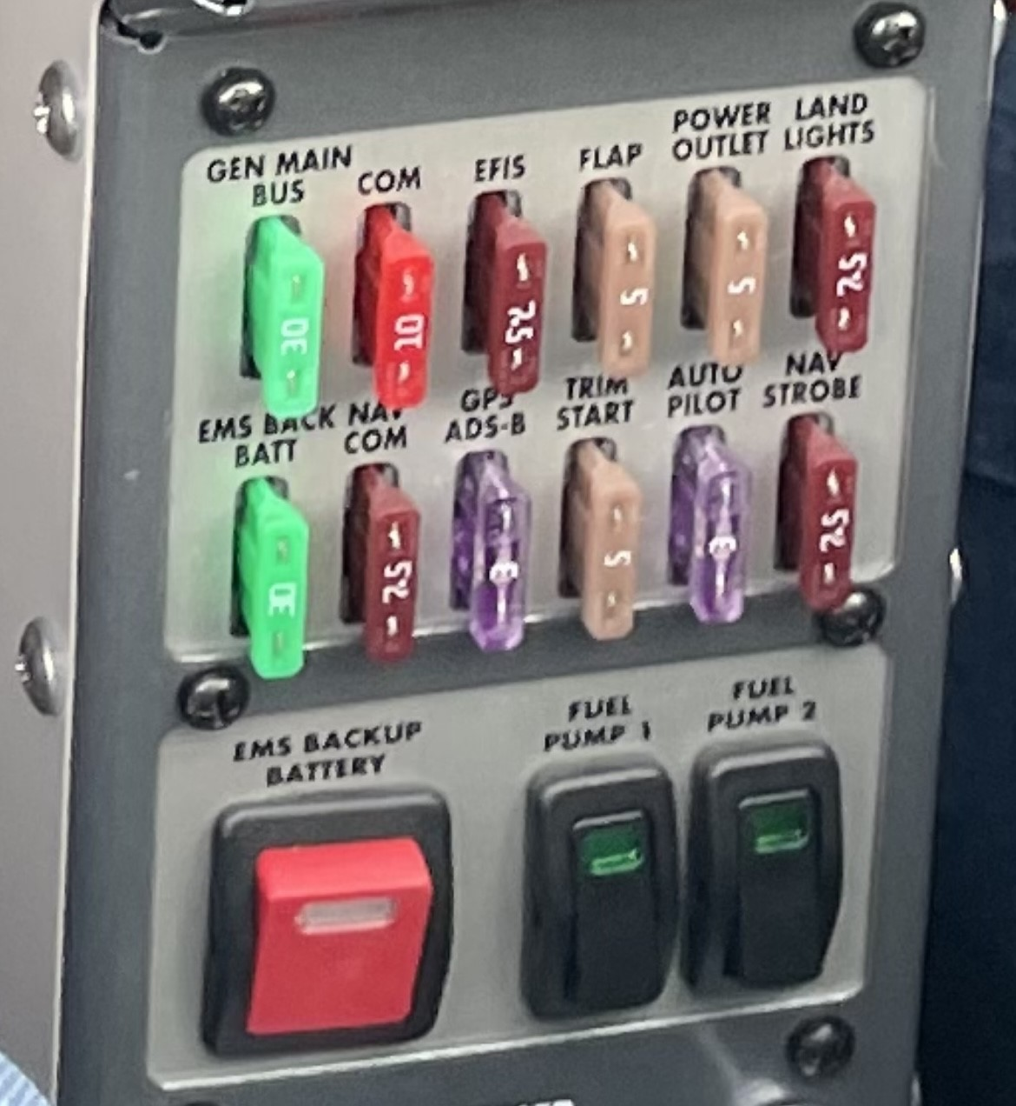
EMS and Generator Operation
Power to the EMS is required to start and keep the engine running, and can come from
Aircraft battery
Generator A
Generator B
If the engine is not running, EMS and the fuel pumps are powered by the aircraft battery.
With the engine running and past the startup sequence:
Generator A powers EMS and fuel pumps
Generator B powers the aircraft (flaps, trim, avionics, radio, lights, and battery charging)
There is no backup battery for EMS, other than the main aircraft battery
The EMS Backup Battery Switch allows the aircraft battery to power the EMS and fuel pumps while the engine is running (in case both generators fail)

Slide 9
Generator A Failure
Generator B stops supplying the aircraft with power, and instead supplies EMS and fuel pump power (to keep the engine running)
The aircraft battery is not being charged, and all power for airplane systems (flaps, trim, avionics, radio, and lights) comes from the aircraft battery
Even if the aircraft battery is completely drained, the engine continues to run
In that case the EFIS has a backup battery that will keep it running, 15.6 amps/hr.
Indications: Flashing of both Lanes A and B fault indicator lights, ammeter discharge, and voltage dropping below 13.0V
Action: Turn off non-essential electrical equipment and land as soon as possible.

Slide 10
Generator B Failure
Generator A continues to supply the EMS and fuel pumps (and run the engine)
The aircraft battery is not being charged, and all power for airplane systems (flaps, trim, avionics, radio, and lights) comes from the aircraft battery
Even if the aircraft battery is completely drained, the engine continues to run
In that case the EFIS has a backup battery that will keep it running for a while
Indications: ammeter discharge, and voltage dropping below 13.0V (no Lane indications)
Action: Turn off non-essential electrical equipment and land as soon as possible

Slide 11
Failure of Both Generators
The engine stops, but can be restarted
Turn off non-essential electrical equipment
Turn on the EMS Backup Battery Switch to power the EMS and fuel pumps from the aircraft battery.
Follow the engine restart procedure
If the aircraft battery power drops too low to run the EMS or fuel pumps, the engine stops.

Slide 12
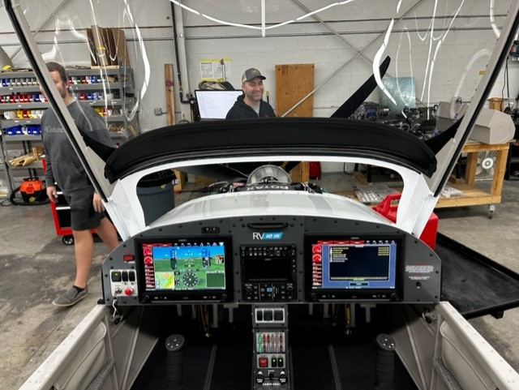
Avionics
Two Garmin G3X Touch displays
GFC 500 Autopilot
Garmin 650

Slide 13
RV-12iS Certification
This aircraft was manufactured in accordance with light sport aircraft airworthiness standards and does not conform to standard category airworthiness requirements.
PARAMETERS OF LSA:
The FAA has defined light-sport aircraft as simple-to-operate, easy-to-fly aircraft that, since initial certification, has continued to meet the following performance definition:
Maximum gross weight of 1,320 lbs
Maximum cruise configuration stall speed of 45 kts CAS
Maximum speed in level flight with maximum continuous power of 120 kts CAS
One- or two-person occupancy (pilot and one passenger)
Fixed or ground adjustable propeller
Fixed landing gear
Single reciprocating engine
Unpressurized cabin

Slide 14
RV-12iS
Flying in the “System”
FLIGHT INTO IMC IS PROHIBITED
Capable of practicing IFR in VFR conditions.
Preflight Note
14 CFR 91.327(e) Each person operating an aircraft issued a special airworthiness certificate in the light-sport category must advise each person carried of the special nature of the aircraft and that the aircraft does not meet the airworthiness requirements for an aircraft issued a standard airworthiness certificate.

Slide 15
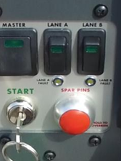
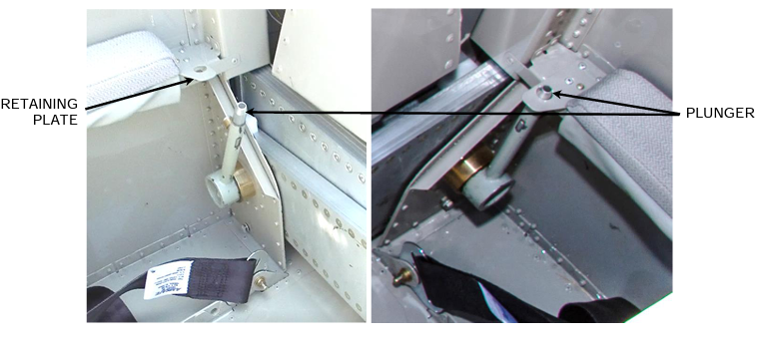
RV-12 Preflight
Spar pins allow us to take wings on/off.
Spar pins override switch: This is a lighted, momentary-contact switch that serves primarily as an indicator of a potential unsafe spar pin condition.
When the indicator is lighted, one or both spar pins are not properly installed.
The starter circuit is disabled when the indicator is lit.
Should the spar pin indication system develop a fault at the same time an in-flight engine re-start is necessary, the disable function may be overridden by pressing the switch while activating the starter.

Slide 16
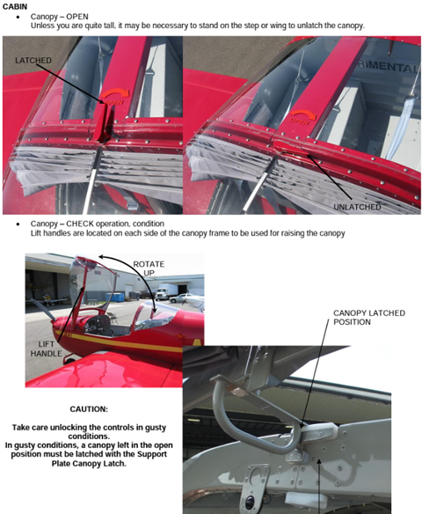
Important notes about the RV-12iS
ALWAYS close the canopy while walking around or away from the aircraft.

Slide 17
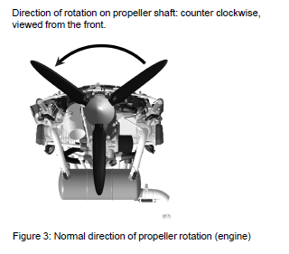
Important Notes about the RV-12iS
NEVER turn the propeller clockwise. Always turn in the direction of rotation.
Turning the propeller in the opposite direction can introduce air into the oil system, which then can make its way back to the lifters.

Slide 18
We plan to pick up N954B next Wednesday the 15th!
We also will be adding N17ER back to the fleet until our second RV-12iS gets here.
N17ER ETA is about 2 weeks out!

